Slide 1
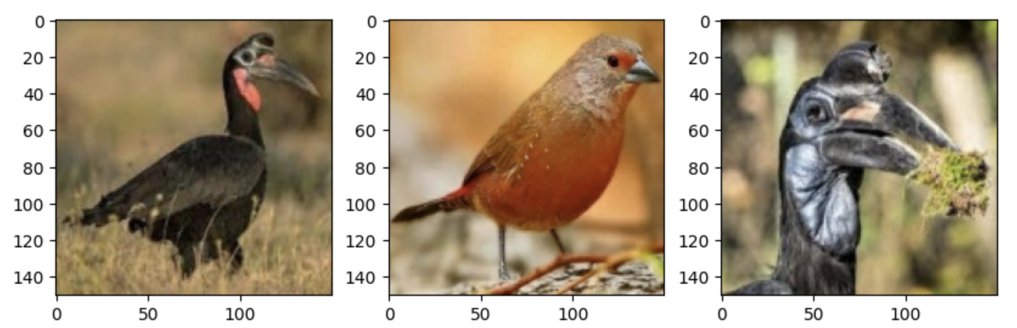
Deep Learning CNN Bird Classifier
By: Lucas Hawranke, Mahmoud El Hazzouri, Mahyar Fazelzade

Slide 2
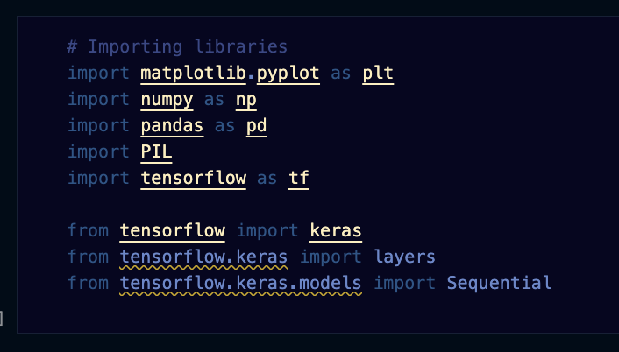
Required Libraries

Slide 3
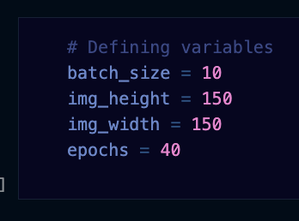
Defining Variables

Slide 4
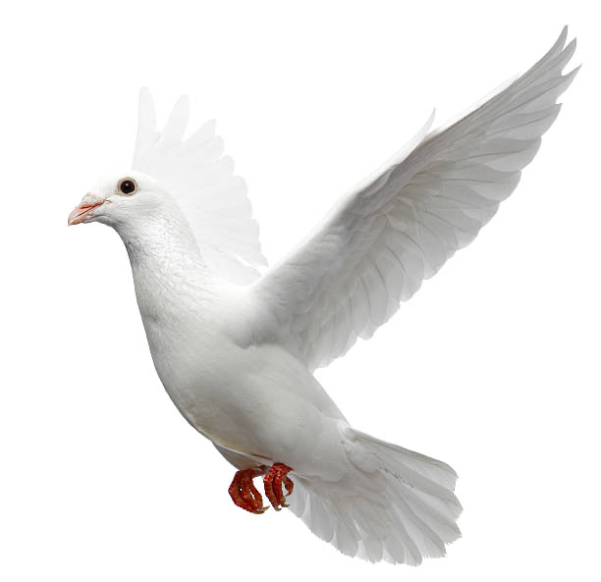
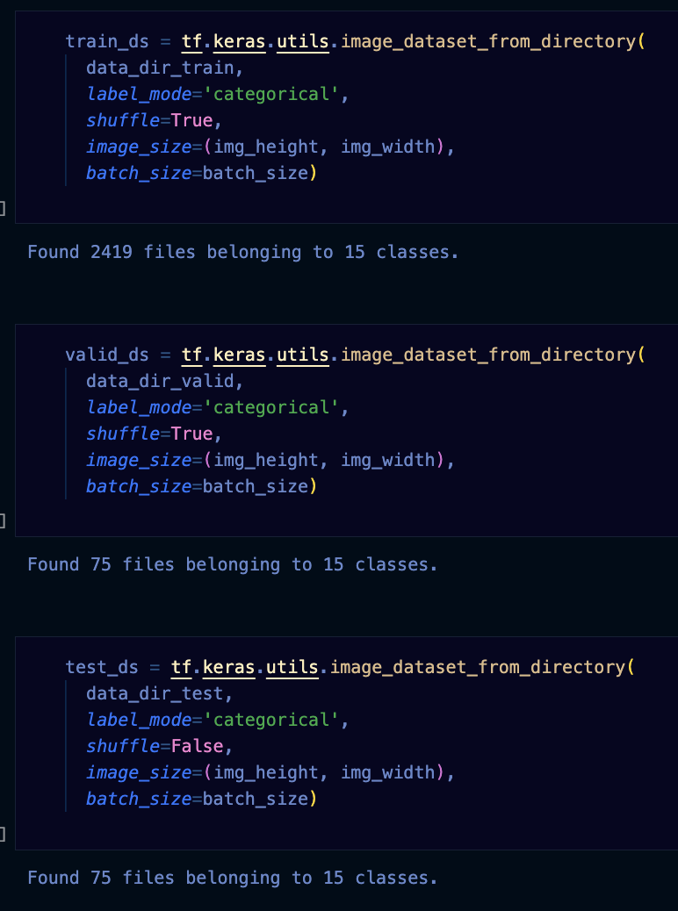
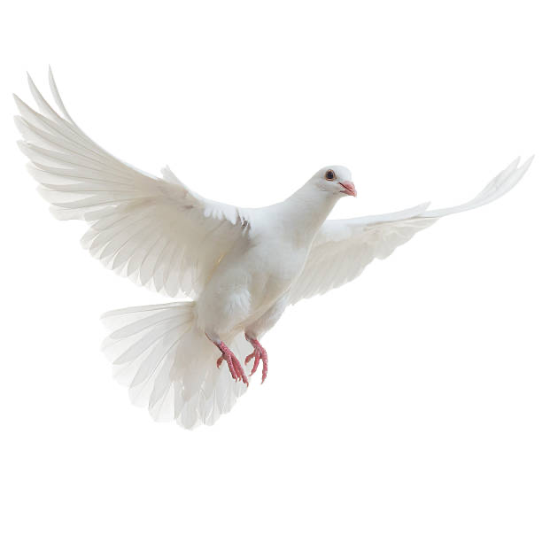
Datasets

Slide 5
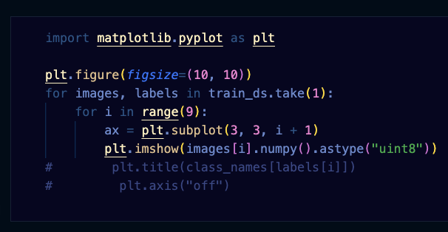
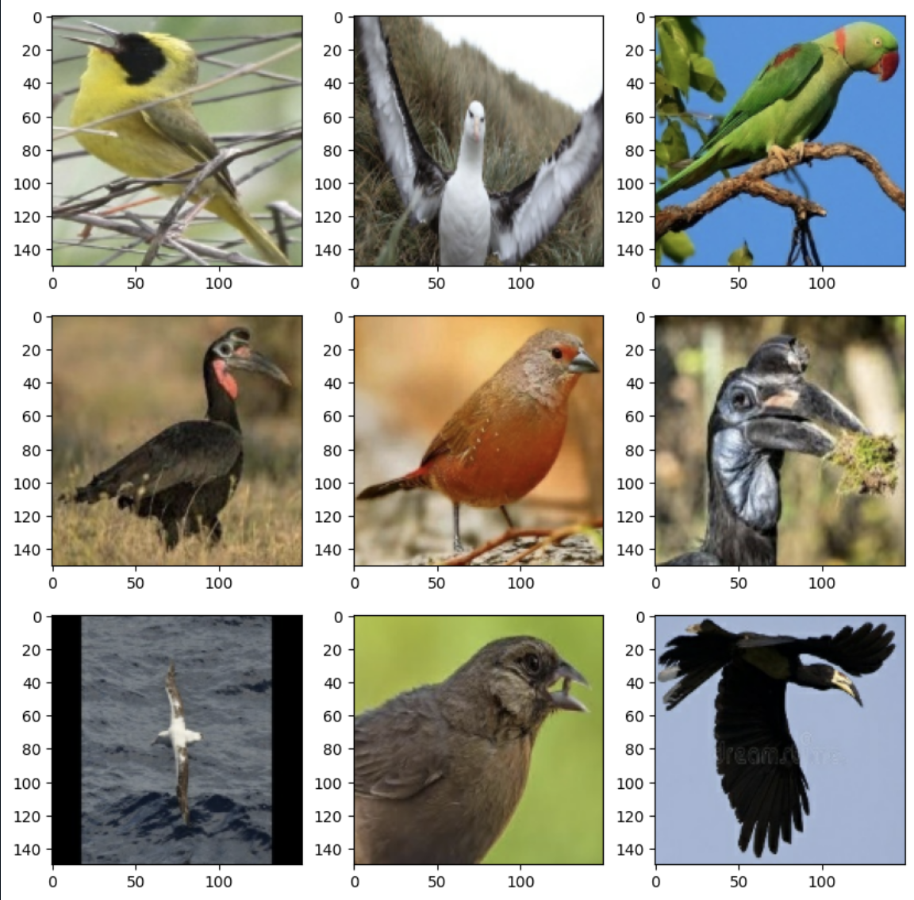
Covering the first 15 classes of birds

Slide 6
Callback/Early Stop

Slide 7
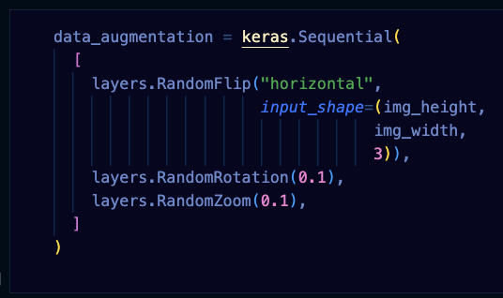
Data Augmentation/Dropout/Softmax

Slide 8
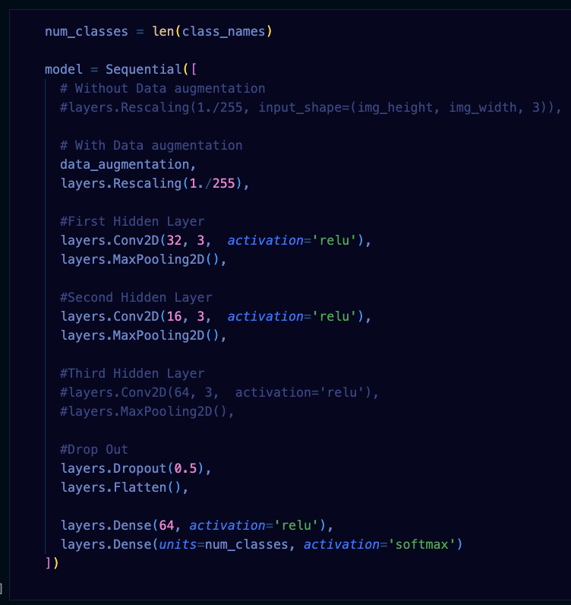
Modelling

Slide 9
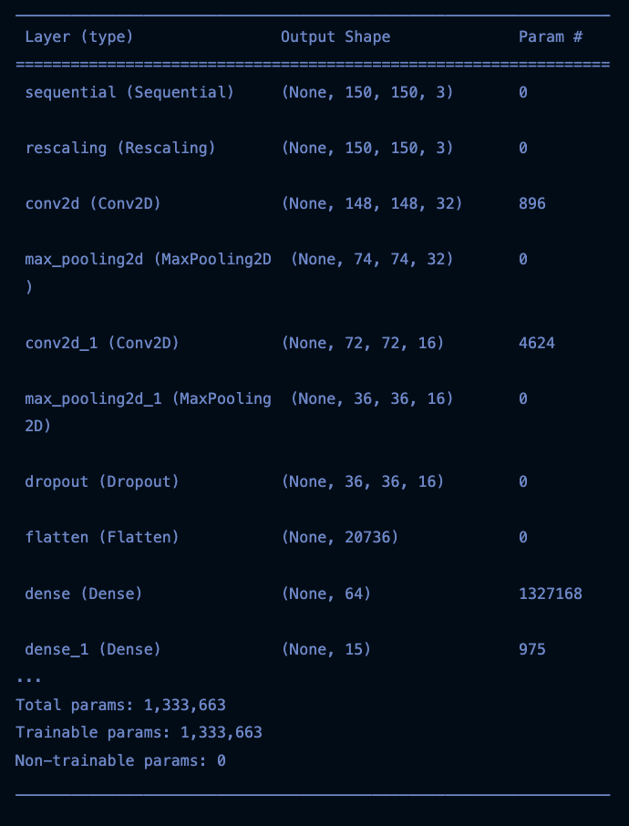
Model Summary

Slide 10
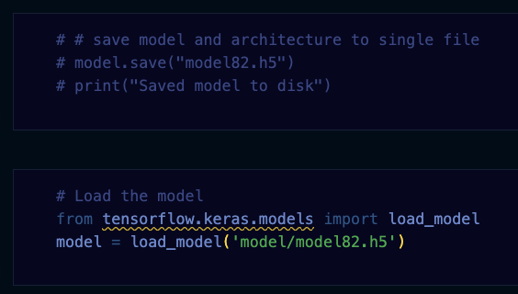
Model Saving/Loading

Slide 11
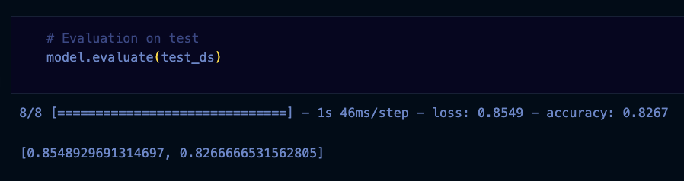
Model Evaluation

Slide 12
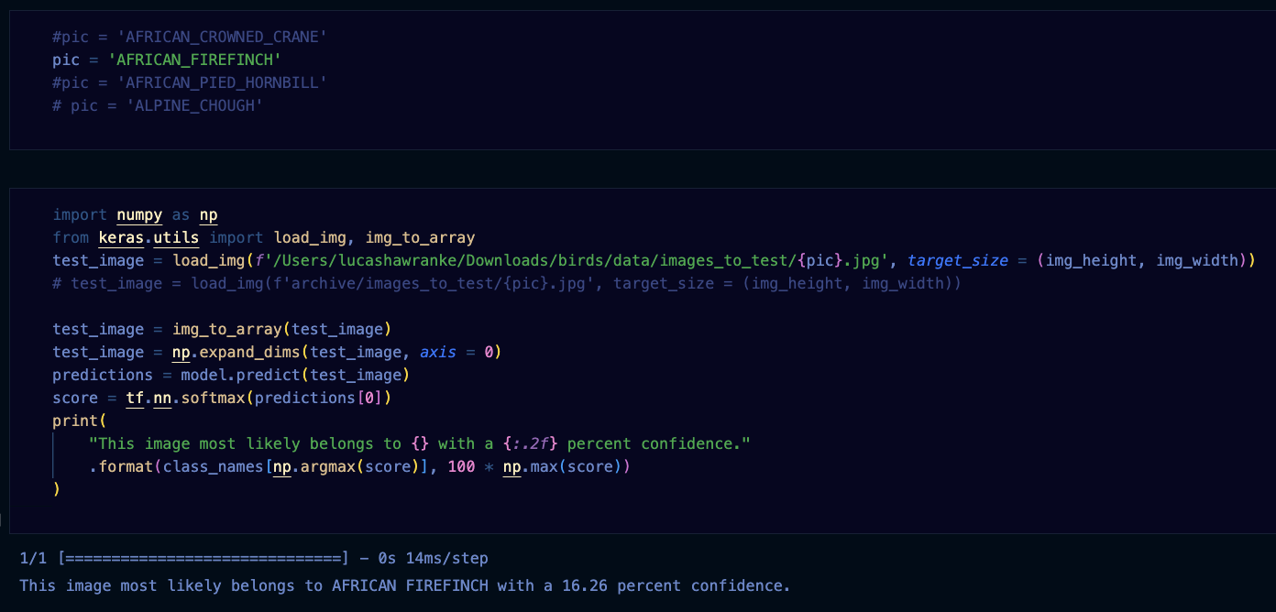
Testing model out with new data

Slide 13
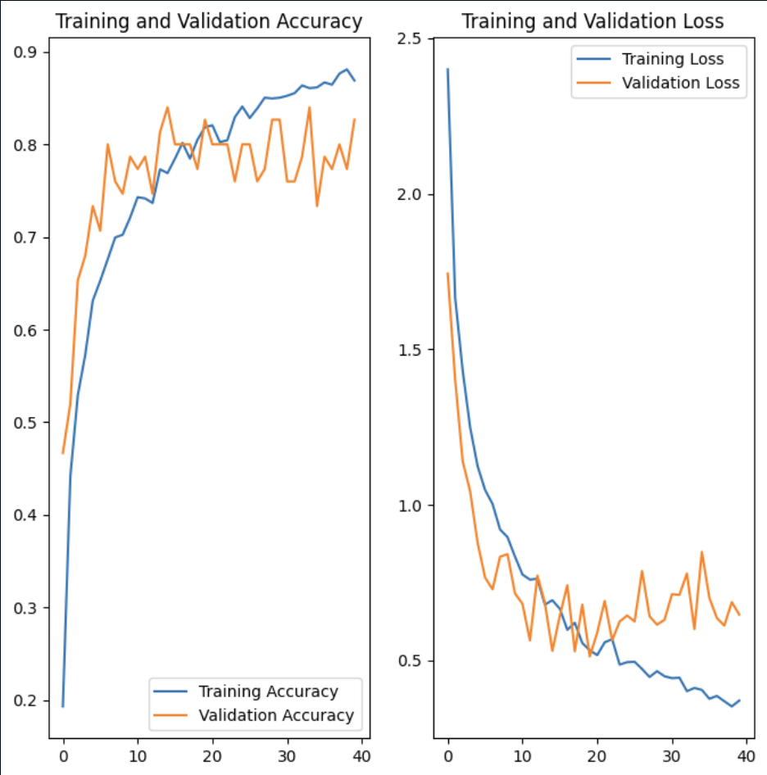
Model’s Performance

Slide 14
In conclusion…

Slide 15

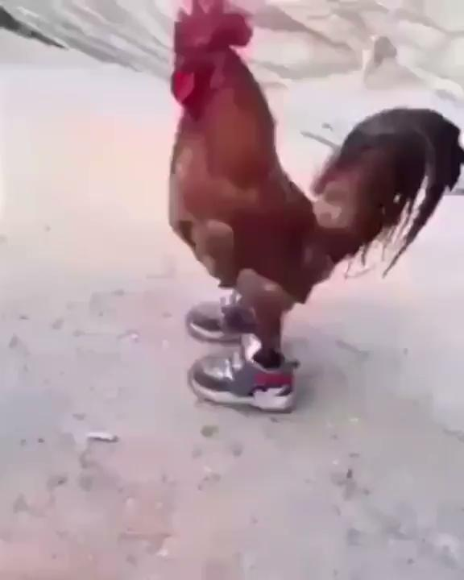
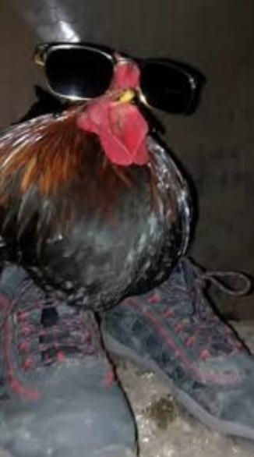
thanks for listening

